Slide 1
EEE 335 Principles of Operating Systems
Principles of I/O Hardware
(Modern Operating Systems 5.1)

Slide 2
Quick Review
What are the advantages of a segmented system?
What are the two major disadvantages of a “pure” segmentation implementation?
Notes:
Advantages:
Easy to link programs together
May be easier to grow/shrink segments
Protection can by assigned to memory by its purpose
Code is more easily shared between processes
Disadvantages:
Segments larger than physical memory cannot be loaded
Memory will become fragmented over time

Slide 3
Outline
I/O Device Categories
Device Controllers
Control Registers
Port-based I/O
Memory-Mapped I/O
Direct Memory Access
Interrupts
Notes:
We saw some of this in the section on computer hardware review. Since it is about to be put to immediate use it is being reviewed and expanded upon.

Slide 4
I/O Device Categories
I/O Devices come in two general types:
Block devices
Character devices
Block devices store data in fixed-sized blocks, each with their own address
Disks are the “poster child” of block devices
Since each block is addressable, each block may be read/written independently of the other blocks
For example, when you save a file to disk, one does not have to read in and re-write their entire hard drive

Slide 5
I/O Device Categories
Character devices deliver/accept a stream of characters without regard to structure
Not addressable
No seek operation
Examples: mice, printers, network interfaces/modems
Some devices straddle the boundary: tape backup is storing/retrieving “blocks” of disk data, but does so sequentially
Notes:
Block vs character is not an absolute classification, meaning not all devices neatly fall into one or the other category.

Slide 6
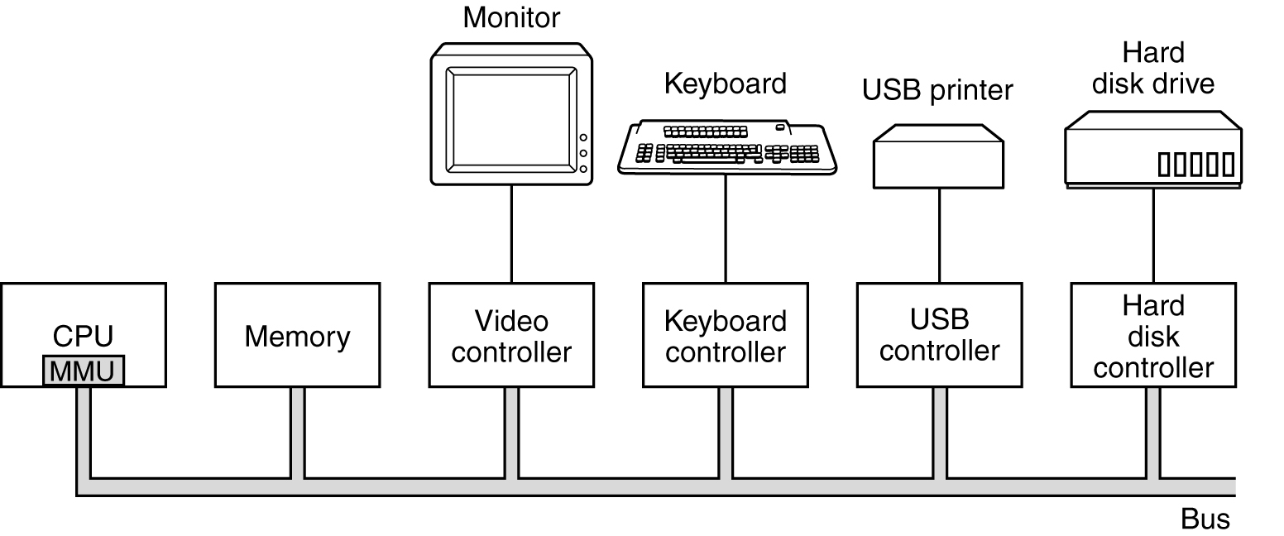
Device Controllers
Recall: I/O devices typically have a mechanical component and a electronic component
The electronic part is the device controller or adapter

Slide 7
Device Controllers
On a PC, the device controller is usually a printed circuit card
It may be integrated with the motherboard
The job of the controller is to convert the serial bit stream into a block of bytes and perform any correction necessary
Notes:
Even on block devices, the read from the head still progresses one bit at a time. The controller must assemble those bits together
Mice, which are character devices, feed their bits serially to the controller. When enough information is assembled to represent a move of the mouse, the controller presents it to the area in memory/interrupt controller
PCIe slot

Slide 8
Control Registers
Each controller has a number of registers so it can be provided with instructions/work
The operating system can command the device to deliver data, accept data, turn off, etc
The OS can read the register to determine the state of a given I/O device
Controllers typically have a data buffer to which the OS can read/write
Important so incoming data is not lost
Sometimes used as “part” of the device, ie, video RAM to which programs can write for display
Notes:
For example, disk controllers have their own buffer, we’ll revisit this shortly

Slide 9
Control Registers
How does the OS communicate with these registers/data buffers?
Two Methods:
Map each control register to an I/O port number
Map each control register into memory space
Hybrid can also exist where data buffers are memory mapped I/O and control registers are mapped to I/O port numbers
Notes:
What are some common ports on PCs?
COM1: I/O port 0x3F8, IRQ 4
COM2: I/O port 0x2F8, IRQ 3
COM3: I/O port 0x3E8, IRQ 4
COM4: I/O port 0x2E8, IRQ 3

Slide 10
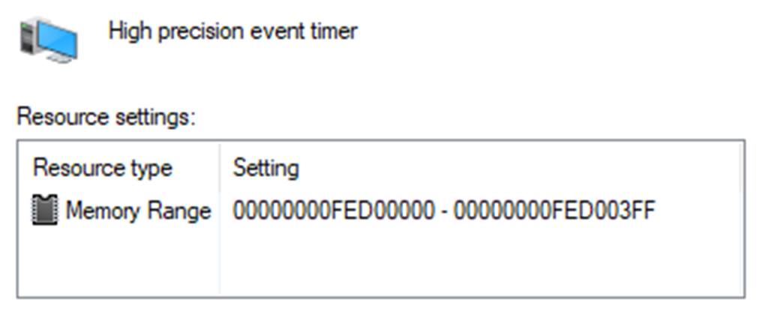
Example – Memory Mapped I/O

Slide 11
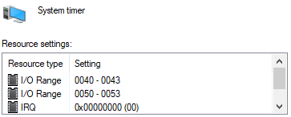
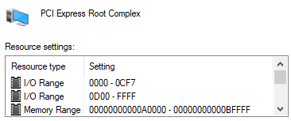
Example –Port and Hybrid Addressing
Notes:
Address, data and control lines

Slide 12
Intel and I/O Port Addresses
The processor’s I/O address space is separate and distinct from the physical-memory address space
The processor supports an I/O address space that contains up to 2¹⁶ or 65,536 (64K) individually addressable 8-bit I/O ports
numbered 0 through FFFFH
Ports that are 16-bit and 32-bit may also be defined in the I/O address space.
Reference: Section 18, I/O Addressing, https://software.intel.com/sites/default/files/managed/39/c5/325462-sdm-vol-1-2abcd-3abcd.pdf

Slide 13
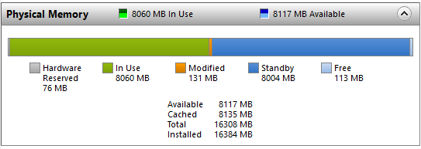
I/O Port Addressing
Consider output from Windows 10 Resource Monitor:
Of the 16GB RAM, a portion is used by the BIOS and I/O port addressing

Slide 14
Port-based I/O
To communicate to device controllers through ports, special I/O instructions must be available on the system
For example, use MOV assembly language command to talk to memory, but IN or OUT to talk to ports
IN R0,4 - read contents I/O port 4, put into R0
MOV R0,4 - read contents of memory word 4, put into R0
Early computers all used this method
Disadvantages:
Special instructions are required
Assembly code will be needed when writing functions that talk to devices.
Special code needed to protect I/O devices
Notes:
Assembly code is needed since we can’t just use the normal C functions for writing to normal addresses in memory. Of course, once the library was written to let us talk to the device we can just use that library, but writing the driver is going to be more difficult
Special code is needed to protect the devices so that processes that don’t have the right privilege levels can’t access certain devices. We’ll see how it’s easier with memory-mapped I/O next.

Slide 15
Memory-Mapped I/O
In this scheme, device control registers are mapped into the address space of the machine
No unique assembly instructions are required to talk to device controllers
Advantages:
No new instructions required, native C language can be used
Device control registers are just variables in memory
Same C language instructions can access both control registers and memory
No special protection mechanisms needed
Normal page/segment protections can be used
Address space containing control registers, not mapped to any processes’ virtual address space
Notes:
For the first advantage, the example is that if there is an instruction called TEST which continually tests a bit in memory for 0 value, and this is how the device signals readiness, we can use this instruction to check our device. Very neat and simple
If using ports, the same test would require multiple steps. The register would have to be read into memory by the CPU and subsequently tested. Twice as many instructions!

Slide 16
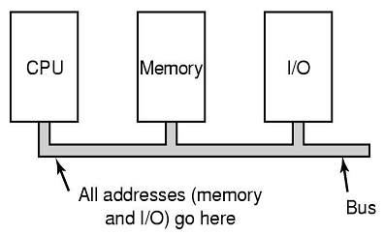
Memory-Mapped I/O
Disadvantages:
Caching is more complex as a scheme is required that will not cache certain pages/segments or the OS will not see the changes in state of devices
caching is disabled for IO addresses
On each memory reference each memory module and I/O device must check to see if they are to respond to the request. This is trivial in the case of a system with a simple bus...
Notes:
Recall memory hierarchy – registers, cache, main memory (RAM), disk memory

Slide 17
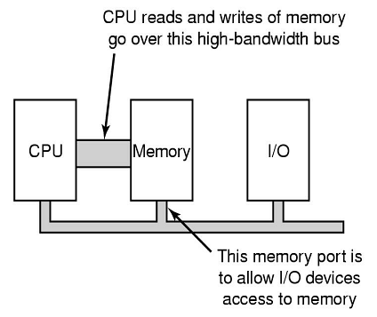
Memory-Mapped I/O
Disadvantages (continued):
...however, most systems provide a high speed bus between the CPU and memory and a system bus:
This makes it difficult for a device to see if it has been addressed. A system must be developed to forward the device addresses to the system bus in case the reference is to I/O and not memory
Notes:
Possible choices to allow I/O devices to see the request:
First send all references to memory. On no response, check with the other busses. Complex.
Put a “snooping” device on the memory bus that forwards on all addresses that may interest I/O devices. Unfortunately, many I/O devices may not be able to keep up with the flow. Need to cache requests, etc
A third possible design is to filter addresses in the memory controller. In that case, the memory controller chip contains range registers that are preloaded at boot time. For example, 640K to 1M − 1 could be marked as a nonmemory range.

Slide 18
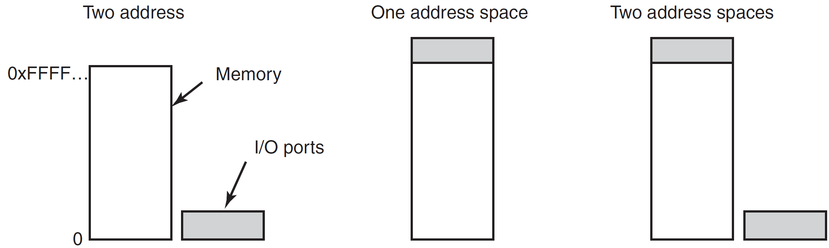
Device Controller Round-Up
Separate I/O Port and Memory Address Space
Memory-mapped I/O
Hybrid Memory and I/O Addressing
A hybrid design can be used to allow I/O control registers to be ports, but have their data buffers as the address space
Notes:
The Pentium uses the hybrid design.
Advantage of the Hybrid is that DMA can be used to talk to the buffers. You wouldn’t typically use DMA to communicate to the ports.
This leads into DMA...

Slide 19
Direct Memory Access (DMA)
DMA is used to free up the CPU from moving bytes of data from devices to memory
It requires another piece of hardware in the system called the DMA controller
The OS/CPU loads the DMA controller’s registers with the information needed to instruct it from what device to get/put the data, where in memory to start writing/reading and how many bytes are to be read/written
Notes:
So, without DMA a disk read involves the disk controller reading a block of data from the drive bit by bit, assembling the block, and performing the checksum to verify the data. Then the controller causes an interrupt to indicate its data is ready. The OS would then take control and read data out one word at a time into the are in memory where the data is required.

Slide 20
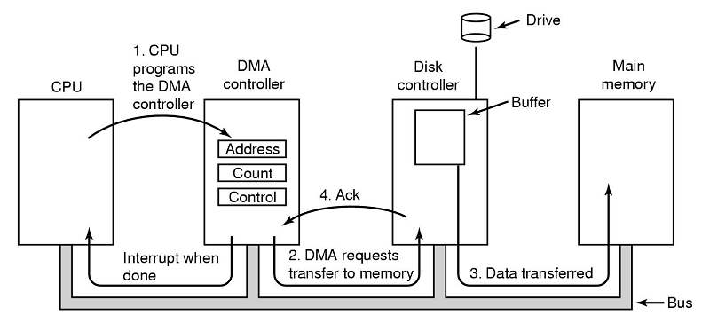
5.
Notes:
From this perspective, DMA is much quicker. The OS simply tells the DMA controller from where, to where, and how much and lets it do its work
The DMA controller ‘steals’ cycles when the bus is not active to move data to memory. Its read requests on the bus look like those the CPU might issue. The controller doesn’t care who it comes from.
The DMA controller will continue to give read/write requests until all the data has been moved. It will then send an interrupt to the CPU

Slide 21
Direct Memory Access
Memory transfer can be word-at-a-time mode and block mode
In word-at-a-time mode, the DMA controller transfers a single byte (or word) for each request
In block or burst mode, the DMA controller transfers a number of bytes at once
It take time to acquire the bus, more efficient to transfer multiple words
More efficient, but may delay the CPU from responding to other work/devices for a time, depending on the burst length

Slide 22
Direct Memory Access
DMA controllers usually use physical addresses for their transfers
Otherwise, they would have to talk to the MMU to get the physical/virtual translation
Some DMA implementations will buffer the information within their own memory space, recall the buffer on the disk controller; this internal buffering:
enables checksum to be verified before transfer
Removes inefficiencies/constant writes to bus, DMA is less time critical
Not all computers use DMA
Not always required
Notes:
Not always needed since, if the devices attached to the computer aren’t slow, the CPU is much faster at moving stuff around than the DMA controller
If the system is more I/O bound than CPU bound it makes sense to let the (fast) CPU do the work instead of the (slow) DMA controller.

Slide 23
Interrupts, revisited
What happens when a device needs attention and signals an interrupt?
Device signals on a line
The interrupt controller, if ready, informs the CPU of a pending interrupt and puts a number on the address bus informing the CPU of which device is causing the interrupt
The CPU uses this address as an offset into a table called the interrupt vector
The entry contained in the table is the address where the interrupt service procedure is located
After it starts executing, the interrupt service procedure signals the interrupt controller that the interrupt is being handled
Avoids potential race conditions involving numerous interrupts

Slide 24
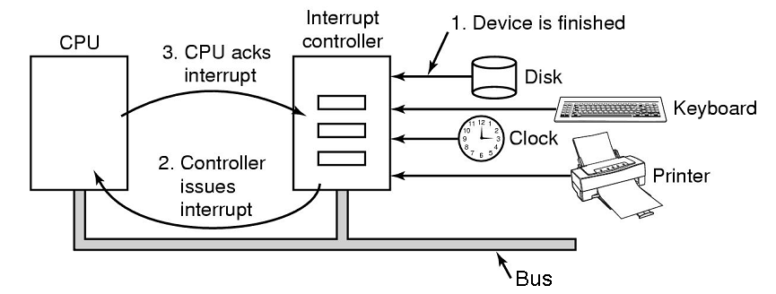
Handling Interrupts
I/O device asserts a signal on bus that it is finished its task
Interrupt controller asserts a signal on the bus to the CPU
It also places a number (of the IO device) on the address line which is used as an index for the interrupt vector that maps to the corresponding interrupt service procedure within the CPU
Interrupt service procedure sends acknowledgement to interrupt controller
Notes:
The CPU waits to ack until it is handling the interrupt to avoid confusing situations. EG: if the CPU acked right away and another interrupt occurred, how would the CPU keep track of them. Usually state is saved on the stack, but nothing has been saved yet. Confusing.

Slide 25
Interrupts – storing of related information
When having to deal with interrupts, CPU needs to store state information
Normally stored on the stack
On what stack does the CPU save current state?
If the user stack is used, how do we know it is valid?
Similarly, what if the stack is valid, but our information fills the current page? Now we may have a page fault in the middle of our interrupt
If the kernel stack is used, the CPU will have to TRAP to kernel mode (which isn’t always required...many device drivers live in user space) requiring more time and a full context switch, invalidating the TLB, cache, etc...
Notes:
At a minimum, the program counter must be saved as well as

Slide 26
Interrupts – Intel perspective
Intel determines which stack to use based on privilege levels
If the code segment for the handler procedure has the same privilege level as the currently executing program or task, the handler procedure uses the current stack;
If the handler executes at a more privileged level, the processor switches to the stack for the handler’s privilege level.
Reference: Section 6.4, Interrupts and Exceptions https://software.intel.com/sites/default/files/managed/39/c5/325462-sdm-vol-1-2abcd-3abcd.pdf

Slide 27
Interrupts – how much information to save
How much state information has to be saved?
Older systems simply saved the state after the CPU finished its last instruction
Modern systems have pipelines. Do you save only the completed instruction or the state of the partially completed instructions?
Superscalar CPUs are even more complicated. Since instructions are completed out of order and then reassembled, how does the OS/CPU simply restart from a single instruction?
Notes:
Pipelines – rather then fetch, decode and execute one instruction at a time, a pipeline can execute multiple instructions at a time. For example, a CPU might have separate fetch, decode, and execute units, so that while it is executing instruction n, it could also be decoding instruction n + 1 and fetching instruction n + 2.
Superscalar – Essentially refers to parallel pipelines.
Three-way superscalar means that by using parallel processing techniques, the processor is able on average to decode, dispatch, and complete execution of (retire) three instructions per clock cycle. To handle this level of instruction throughput, the P6 processor family uses a decoupled, 12-stage superpipeline that supports out-of-order instruction execution.

Slide 28
Precise and Imprecise Interrupts
Some systems provide interrupts that are called “precise interrupts”
Precise interrupts leave the machine in a well defined state and have four properties
The Program Counter (PC) is saved in a known place
All instructions before the one pointed to by the PC have fully executed
No instructions beyond the PC have been executed
The execution state of the instruction pointed to by the PC is known
Notes:
Pipelining is complicating the interrupt handling because multiple instruction in incomplete status may exist.
Superscalar CPU = multiple execution units.
Precise Interrupt mean the state when the interrupt comes is well-defined.
Without precise interrupts on a superscalar system, a large volume of information is vomited onto the stack and the writer of the OS has to code a routine to figure it all out.
The Intel series, which has been superscalar since PRO, gives precise interrupts.

Slide 29
Precise and Imprecise Interrupts
Machines with imprecise interrupts “usually vomit a large amount of internal state onto the stack”
Now, after the interrupt, the OS must have the necessary functions to figure out what was going on at the time of the interrupt
The code to do this can be complicated
Saving large amounts of information can make interrupts and recovery from them slow
Notes:
Pipelining is complicating the interrupt handling because multiple instruction in incomplete status may exist.
Superscalar CPU = multiple execution units.
Precise Interrupt mean the state when the interrupt comes is well-defined.
Without precise interrupts on a superscalar system, a large volume of information is vomited onto the stack and the writer of the OS has to code a routine to figure it all out.
The Intel series, which has been superscalar since PRO, gives precise interrupts.

Slide 30
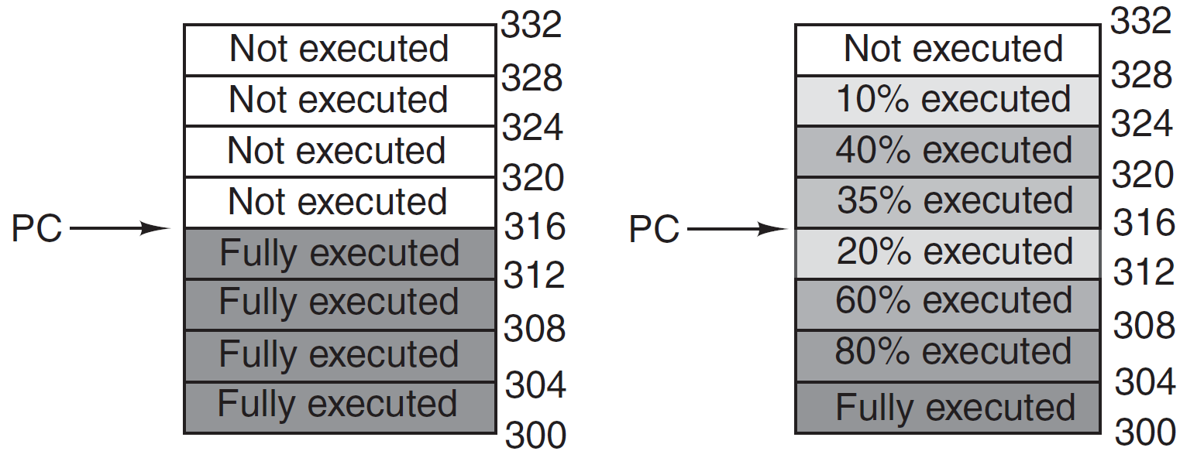
Precise and Imprecise Interrupts
Precise
Imprecise
Notes:
The Intel series, which has been superscalar since PRO, gives precise interrupts.

Slide 31
Quiz Time!
What is burst mode?
Why is caching more difficult to implement with memory-mapped I/O?
Notes:
What is burst mode?
A DMA mode where a number of bytes are transferred at once to complete the I/O expediently.
Why is caching more difficult to implement with memory-mapped I/O?
Because it must be disabled for those addresses that are mapped to physical devices.

Slide 32
Principles of I/O Software Part I

